Slide 1

Web and Cloud Security
Department of Economic Informatics and Cybernetics
Bucharest University of Economic Studies
ASP.NET MVC Core 2 – Part II
Liviu-Adrian Cotfas, PhD.
liviu.cotfas@ase.ro

Slide 2

ASP.NET MVC Core, C# Language
url: https://docs.microsoft.com/en-us/aspnet/
C#

Slide 3

About me
https://ro.linkedin.com/in/cotfasliviu

Slide 4
Administrative issues
Recommended Reading / Watching
Pro ASP.NET Core 3
ADAM FREEMAN
Now in its 8th edition, the best-selling book on MVC is now updated for ASP.NET Core.
https://www.apress.com/gp/book/9781484254394
https://github.com/Apress/pro-asp.net-core-3
Notes:
https://www.apress.com/gp/book/9781484252833

Slide 5

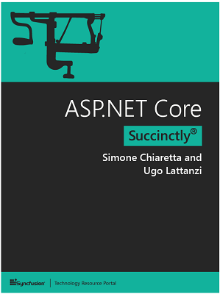
Administrative issues
Recommended Reading / Watching
ASP.NET Core Succinctly (Free)
Simone Chiaretta and Ugo Lattanzi
In ASP.NET Core Succinctly, seasoned authors Simone Chiaretta and Ugo Lattanzi update you on all the advances provided by Microsoft’s landmark framework.
https://www.syncfusion.com/resources/techportal/details/ebooks/ASP_NET_Core_Succinctly

Slide 6
Administrative issues
Further Reading / Watching
Courses on Microsoft Learn - https://docs.microsoft.com/en-us/learn/
Free
Courses on PluralSight - www.pluralsight.com
Free trial (10 days)
Free limited access through https://azure.microsoft.com/en-us/free/students/

Slide 7
Administrative issues
API reference and Source code
Documentation:
https://docs.microsoft.com/en-us/aspnet/
API reference:
https://docs.microsoft.com/en-us/dotnet/api/?view=net-5.0
Source code:
https://github.com/aspnet/Home
Various samples:
https://code.msdn.microsoft.com/

Slide 8
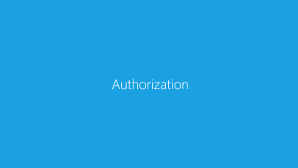
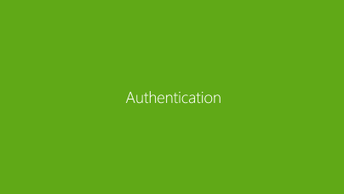
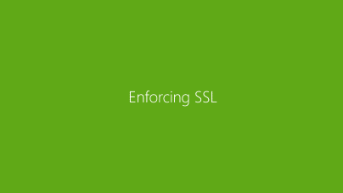
Contents

Slide 9
Security in ASP.NET Core
ASP.NET Core enables developers to easily configure and manage security for their apps. ASP.NET Core contains features for managing authentication, authorization, data protection, SSL enforcement, app secrets, anti-request forgery protection, and CORS management. These security features allow you to build robust yet secure ASP.NET Core apps.
Further reading: https://docs.microsoft.com/en-us/aspnet/core/security

Slide 10
Authentication

Slide 11
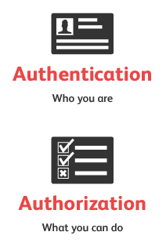
Authentication
Authentication - determining the identity of a user.
Authorization - determining whether a user is allowed to perform an action

Slide 12
Authentication
ASP.NET Core Identity
ASP.NET Core Identity is an API from Microsoft to manage users in ASP.NET applications
Users can create an account and login with their Active Directory account, with a user name and password or they can use an external login providers such as Facebook, Google, Microsoft Account, Twitter and more
ASP.NET Core Identity can be configured to use a SQL Server database to store user names, passwords, and profile data. Alternatively, you can use your own persistent store to store data in another persistent storage, such as Azure Table Storage
OSS alternatives are also available: link

Slide 13
Authentication
ASP.NET Core Identity
Why is it useful?
User management is an important feature for most applications, and ASP.NET Core Identity provides a ready-made and well-tested platform that doesn’t require you to create custom versions of commonly demanded functions.
NuGet Package:
Microsoft.AspNetCore.Identity.EntityFrameworkCore
Documentation: link

Slide 14
Authentication
IdentityUser Class
AccessFailedCount | Gets or sets the number of failures for the purposes of lockout.(Inherited from IdentityUser(Of TKey, TLogin, TRole, TClaim).)
Email | Gets or sets the email for the user.(Inherited from IdentityUser(Of TKey, TLogin, TRole, TClaim).)
EmailConfirmed | Gets or sets a value that indicates whether the email is confirmed.(Inherited from IdentityUser(Of TKey, TLogin, TRole, TClaim).)
Id | Gets or sets the user identifier.(Inherited from IdentityUser(Of TKey, TLogin, TRole, TClaim).)
LockoutEnabled | Gets or sets a value that indicates whether lockout enabled for this user.(Inherited from IdentityUser(Of TKey, TLogin, TRole, TClaim).)
LockoutEndDateUtc | Gets or sets the date time value (in UTC) when lockout ends, any time in the past is considered not locked out.(Inherited from IdentityUser(Of TKey, TLogin, TRole, TClaim).)
Logins | Gets the collection of logins for the user.(Inherited from IdentityUser(Of TKey, TLogin, TRole, TClaim).)

Slide 15
Authentication
IdentityUser Class
PasswordHash | Gets or sets the salted/hashed form of the user password.(Inherited from IdentityUser(Of TKey, TLogin, TRole, TClaim).)
PhoneNumber | Gets or sets the phone number for the user.(Inherited from IdentityUser(Of TKey, TLogin, TRole, TClaim).)
PhoneNumberConfirmed | Gets or sets the value that indicates whether the phone number is confirmed. The default is false.(Inherited from IdentityUser(Of TKey, TLogin, TRole, TClaim).)
Roles | Gets the collection of roles for the user.(Inherited from IdentityUser(Of TKey, TLogin, TRole, TClaim).)
SecurityStamp | Gets or sets a random value that changes when a user’s credentials change.(Inherited from IdentityUser(Of TKey, TLogin, TRole, TClaim).)
TwoFactorEnabled | Gets or sets a value that indicates whether two-factor authentication is enabled for the user.(Inherited from IdentityUser(Of TKey, TLogin, TRole, TClaim).)
UserName | Gets or sets the user name.(Inherited from IdentityUser(Of TKey, TLogin, TRole, TClaim).)

Slide 16
Authentication
ASP.NET Core Identity
The identity services should be added to the application in the ConfigureServices method in the Startup class:
public void ConfigureServices(IServiceCollection services)
{
services.AddDbContext<ApplicationDbContext>(options =>
options.UseSqlServer(
Configuration["Data:Database:ConnectionString"]));
services.AddTransient<IProductRepository, EFProductRepository>();
services.AddIdentity<IdentityUser, IdentityRole>()
.AddEntityFrameworkStores<ApplicationDbContext>();
services.AddMvc();
}

Slide 17
Authentication
Configure Identity
Password policy:
User's lockout:
options.Password.RequireDigit = true;
options.Password.RequiredLength = 8;
options.Password.RequireNonAlphanumeric = false;
options.Password.RequireUppercase = true;
options.Password.RequireLowercase = false;
// Lockout settings
options.Lockout.DefaultLockoutTimeSpan = TimeSpan.FromMinutes(30);
options.Lockout.MaxFailedAccessAttempts = 10;
options.Lockout.AllowedForNewUsers = true;

Slide 18
Authentication
Configure Identity
Application's cookie settings:
// Cookie settings
options.Cookies.ApplicationCookie.CookieName = "YouAppCookieName";
options.Cookies.ApplicationCookie.ExpireTimeSpan = TimeSpan.FromDays(150);
options.Cookies.ApplicationCookie.LoginPath = "/Account/LogIn";
options.Cookies.ApplicationCookie.LogoutPath = "/Account/LogOff";
options.Cookies.ApplicationCookie.AccessDeniedPath = "/Account/AccessDenied";
options.Cookies.ApplicationCookie.AutomaticAuthenticate = true;
options.Cookies.ApplicationCookie.AuthenticationScheme = Microsoft.AspNetCore.Authentication.Cookies.CookieAuthenticationDefaults.AuthenticationScheme;
options.Cookies.ApplicationCookie.ReturnUrlParameter = Microsoft.AspNetCore.Authentication.Cookies.CookieAuthenticationDefaults.ReturnUrlParameter;

Slide 19

Authentication
Authentication using Facebook, Google
Enabling users to sign in with their existing credentials is convenient for the users and shifts many of the complexities of managing the sign-in process onto a third party.
How to implement: link
Introduction to OAuth 2: link

Slide 20

Authentication
Demo
https://github.com/liviucotfas/ase-web-and-cloud-applications-security/blob/master/6%20-%20MVCStore%20-%20Security.md

Slide 21
Authentication
Recommended reading
Configure Identity primary keys data type: link
Two-factor authentication with SMS: link
Azure Active Directory: link

Slide 22
Authorization

Slide 23
Authorization
Authorization - determining whether a user is allowed to perform an action
Example: an administrative user is allowed to create a document library, add documents, edit documents, and delete them. A non-administrative user working with the library is only authorized to read the documents.
Authorization is orthogonal and independent from authentication, which is the process of ascertaining who a user is. Authentication may create one or more identities for the current user.
Notes:
References:
https://docs.microsoft.com/en-us/aspnet/core/security/authorization/introduction

Slide 24
Authorization
ASP.NET Core authorization provides a simple declarative role and a policy based model.
Authorization is expressed in requirements, and handlers evaluate a user's claims against requirements. Imperative checks can be based on simple policies or policies which evaluate both the user identity and properties of the resource that the user is attempting to access.
Namespace: Microsoft.AspNetCore.Authorization
Further reading: link
Notes:
References:
https://docs.microsoft.com/en-us/aspnet/core/security/authorization/introduction

Slide 25
Authorization
[Authorize]
[AuthorizeAttribute]
tells MVC that only requests from authenticated users should be processed
properties: Roles, Policy
can be applied both at action and at controller level
The ASP.NET platform provides information about the user through the HttpContext object, which is used by the Authorize attribute to check the status of the current request and see whether the user has been authenticated. The HttpContext.User property returns an implementation of the IPrincipal interface, which is defined in the System.Security.Principal namespace.

Slide 26
Authorization
[Authorize]
action level
controller level
public class HomeController : Controller {
[Authorize]
public ViewResult Index(){
return View();
}
}
[Authorize]
public class HomeController : Controller {
public ViewResult Index(){
return View();
}
}

Slide 27
Authorization
[Authorize]
Imperative
Declarative (recommended)
public ActionResult Details(int id)
{
if (!User.IsInRole("EmployeeViewer"))
return new HttpUnauthorizedResult();
// Action logic
}
[Authorize(Roles = "EmployeeViewer")]
public ActionResult Details(int id)
{
// Action logic
}

Slide 28
Authorization
Security Attributes
[AllowAnonymous]
Specifies that actions and controllers are skipped by AuthorizeAttribute during authorization.
Example: the login action
[Authorize]
public class AccountController : Controller {
[AllowAnonymous]
public IActionResult Login() {
return View();
}
[HttpPost]
[AllowAnonymous]
[ValidateAntiForgeryToken]
public async Task<IActionResult> Login(LoginModel details) {
return View(details);
}
}

Slide 29
Enforcing SSL
Notes:
https://docs.microsoft.com/en-us/aspnet/core/security/enforcing-ssl

Slide 30
Authorization
Enforcing SSL
[RequireHttpsAttribute]
can be used to decorate controllers or actions;
Can also be configured globally:
Note: The highlighted code above requires all requests to use HTTPS, therefore HTTP requests are ignored.
// Requires using Microsoft.AspNetCore.Mvc;
public void ConfigureServices(IServiceCollection services){
services.Configure<MvcOptions>(options =>
{
options.Filters.Add(new RequireHttpsAttribute());
});

Slide 31
Authorization
Enforcing SSL
Redirects all HTTP requests to HTTPS:
Further reading: docs.microsoft.com/en-us/aspnet/core/security/enforcing-ssl
public void Configure(IApplicationBuilder app, IHostingEnvironment env)
{
…...
app.UseHttpsRedirection();
app.UseStaticFiles();
app.UseCookiePolicy();
app.UseMvc();
}

Slide 32
Authorization
HTTP Strict Transport Security Protocol (HSTS)
Is an opt-in security enhancement that's specified by a web app through the use of a response header.
When a browser that supports HSTS receives this header:
The browser stores configuration for the domain that prevents sending any communication over HTTP. The browser forces all communication over HTTPS.
The browser prevents the user from using untrusted or invalid certificates. The browser disables prompts that allow a user to temporarily trust such a certificate.
Further details: docs.microsoft.com/en-us/aspnet/core/security/enforcing-ssl

Slide 33
Authorization
HTTP Strict Transport Security Protocol (HSTS)
public void Configure(IApplicationBuilder app, IHostingEnvironment env)
{
if (env.IsDevelopment())
{
app.UseDeveloperExceptionPage();
}
else
{
app.UseExceptionHandler("/Error");
app.UseHsts();
}
…
}

Slide 34
Thank you!

